Slide 1


DATA NETWORKS
LESSON 3
Application Layer
2-<number>

Slide 2
Application layer
Learning outcomes:
Application layer concepts
Understand the application-level protocols
  HTTP
  SMTP / POP3 / IMAP
  DNS
  FTP
Computer Networking: A Top-Down Approach. 7th edition. Jim Kurose, Keith Ross – Pearson (2017).
Application Layer
2-<number>

Slide 3
Application layer
Topmost layer in the OSI model (Layer 7)
Responsible for providing services to user applications
defines how an application’s processes, running on different end systems, pass messages to each other
Relies on the below layers to communicate. E.g. relies on transport layer protocols services.
Process: A Program, Software or Application running within a host.
Two processes communicating on the same host = inter-process communication (defined by the OS)
Processes in different hosts communicate by exchanging messages.
Application Layer
2-<number>

Slide 4
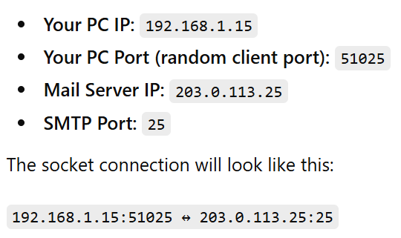
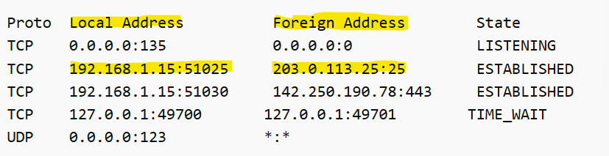
Application layer…
To send/ receive messages, a process must have an identifier = Socket.
A socket is a communication endpoint used by applications to send and receive data over a network.
Devices communicate through a socket pair
socket = IP address(which device) + port number(which application)
Example: Your PC communicating with a Mail Server (SMTP)
Processes running on a host
2-<number>

Slide 5
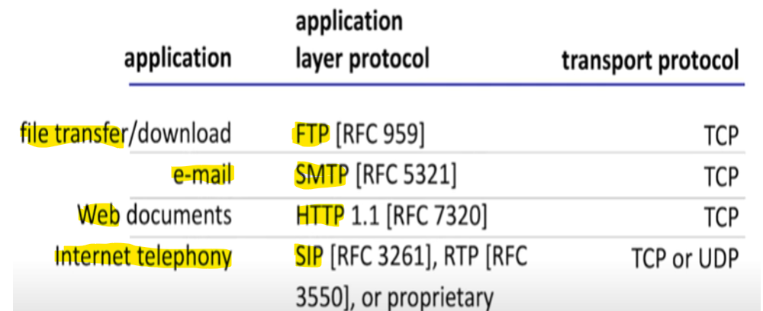
Application layer…
Common applications and the application layer protocols.
E.g. Social media, Web, messaging, video / audio streaming, VOIP applications.
Internet applications and Transport Layer protocols
Application Layer
2-<number>

Slide 6
App-layer protocols define how applications on different devices communicate :
Types of messages exchanged:
  What messages are sent: request, response
  e.g. Browser requests a page from a Webserver
Message syntax:
  How messages are structured(format)
  E.g fields in an email (subject/body/to/from/cc)
Message semantics
  What the information in the fields mean
  E.g “Subject” field in an email
Rules
when and how applications send/receive messages
Two types of Protocols:
Open protocols:
Standardized, publicly documented (defined in RFCs)
Anyone can use them without restrictions.
Works across different platforms (promotes interoperability)
e.g., HTTP, SMTP
Proprietary protocols:
Owned by a company/entity
implementation is restricted
e.g., CISCO HSRP – used to implement router redundancy. Other vendors use open protocol such as VRRP
2-<number>

Slide 7
The Web
A Web page consists of objects
Objects can be HTML files, images (JPEG, GIF), audio, video file etc.
Each object is addressable/referenced by a URL, e.g.,
www.someschool.edu/someDept/pic.gif
host name
path name
Application Layer
2-<number>

Slide 8
The Web…
WWW = A system of interlinked documents and resources, accessed via the Internet using a web browser.
Built on top of Internet protocols
for example: A web browser loads a webpage using various protocols:
  It uses the DNS protocol to convert a domain name into an IP address.
  It uses HTTP to request the webpage contents from that IP address (server).
  It may also use the TLS protocol to serve the website over a secure, encrypted connection.
Application Layer
2-<number>

Slide 9


HTTP overview
HTTP: hypertext transfer protocol
Application layer protocol – enables web client <> web server communication.
Uses Port 80
client/server model
  client: browser that requests, receives and displays Web objects/content.
  server: Web server sends web content/objects in response to client requests
HTTP request
PC running
Firefox browser
HTTP response
HTTP request
Web
server
HTTP response
iPhone running
Safari browser
Application Layer
2-<number>

Slide 10
HTTP overview
HTTP uses TCP:
TCP establishes a connection between devices to ensure reliable data delivery.
Client-server connection:
1. client initiates TCP connection to the server, port 80
2. server accepts TCP connection from client
3. HTTP messages are exchanged between the Web client(browser) and Web server (HTTP server)
4. TCP connection closed
SSL (Secure Sockets Layer)
Provides secure communication channel between two applications over a network – used in HTTPS
Encrypts TCP connection between client and server to protect data
HTTPS uses port 443 – Secure than standard HTTP(plaintext)
Application Layer
2-<number>

Slide 11
HTTP connections
1. persistent HTTP
multiple objects can be sent over a single TCP connection between the client, and server before the connection is closed.
HTTP 1.1 - Mordern
2. non-persistent HTTP
at most one object sent over a TCP connection
  connection then closed
downloading multiple objects required multiple connections
Browser opens multiple parallel TCP connections to fetch objects in parallel.
HTTP 1.0 – Old websites ,early 2000’s

Slide 12
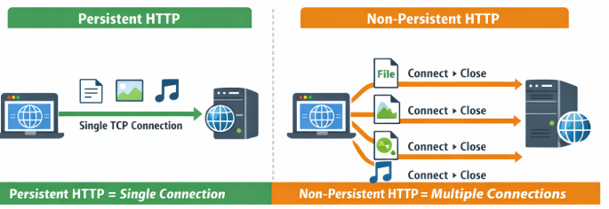
HTTP connections
Example: non-persistent HTTP
Companys’ internal HR portal from the early 2000s.
When an employee requests a pay slip (file 1), the browser opens a TCP connection, downloads the file, then closes the connection.
Next, if the employee wants the leave balance (file 2), a new TCP connection is opened and closed again.
Key idea: Every object requires its own TCP connection → slow and inefficient

Slide 13
Non-persistent HTTP
suppose user enters URL:
(client wants to
reference 10
jpeg images)
www.nust.na/someFaculty/Isnotes/home.index
1a. HTTP client initiates TCP connection to HTTP server (process) at www.nust.na on port 80
1b. HTTP server at host www.nust.na waiting for TCP connection at port 80. “accepts” connection, notifying client
2. HTTP client sends HTTP request message (containing URL) into TCP connection socket. Message indicates that client wants object someDepartment/home.index
3. HTTP server receives request message, forms response message containing requested object, and sends message into its socket
time
Application Layer
2-<number>

Slide 14
Non-persistent HTTP
4. HTTP server closes TCP connection.
5. HTTP client receives response message containing html file, displays html file & requested resources.
time
6. Steps 1-5 repeated for each of of the10 jpeg objects
Application Layer
2-<number>

Slide 15
Persistent HTTP
The server leaves the TCP connection open after sending a response
Subsequent HTTP messages between the client and server are sent over the same open TCP connection.
Reduces response time compared to non-persistent connection.
Application Layer
2-<number>

Slide 16
HTTP request message
Two types of HTTP messages: request, response
HTTP request message:
  Resource request sent from browser to server.
  Represented in ASCII encoding (human-readable text format) - bits represented in standard text.)
HTTP Request messages has 3 main parts:
  Request Line = Tells the server: what to do (GET, POST, DELETE), Which file to return, HTTP version.
  Header Line = Give extra information about the request. E.g Host(website name), User-Agent(browser name), Accept(file type browser can handle), Accept-Language(language the browser prefers)
  Blank Line = indicates the end of the header section
Application Layer
2-<number>

Slide 17
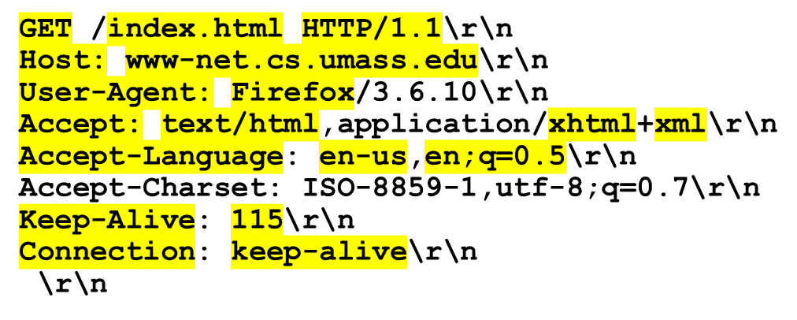
HTTP request message
Two types of HTTP messages: request, response
HTTP request message:
  Resource request from browser to server.
  Represented in ASCII encoding (human-readable text format) - bits represented in standard text.)
End of the request line
request line
(GET, POST,
HEAD methods)
header
lines
blank line – indicates end of header lines
HTTP REQUEST EXAMPLE
Application Layer
2-<number>

Slide 18
HTTP Request Method types
Specifies the action that a client wants to perform on a resource. e.g a document: get it, update it, or delete it
1. GET
Generally used for retrieving a resource from the server e.g a webpage, document etc
Example: Downloading a PDF
2. PUT
Used to update an existing resource or create a new resource if it does not exist .
Example: Updating a user profile or uploading a file
3. POST
used to submit data to the server for processing
Common use: sending form inputs or user data
Example: Filling out and submitting an online registration form
4. HEAD
requests the headers of the GET response, but not the body.
useful for checking metadata (content length (size), last modified)
5. DELETE
used to request that a specified resource be removed or deleted.

Slide 19
HTTP response status codes
status code appears in the 1st line in server-to-client response message.
some sample codes:
200 OK
  request succeeded
  Example: Webpage loaded successfully
301 Moved Permanently
  requested resource moved to a new URL
  Example: Old e-learning webpage has a new address. User redirected automatically without seeing the 301 code
404 Not Found
  The requested resources is not found on the server
  Example: You click on a URL to a page that was removed or moved without redirect. Clicking www.school.com/old-lesson.html but the lesson has been deleted
  Example: Typing the wrong URL. Typo in the address bar, like www.google.com/searhc → server has no resource at that path
505 HTTP
Server does not support the HTTP version used in the request
Example: Browser sends HTTP/1.1 request to an old server supporting only HTTP/1.0

Slide 20
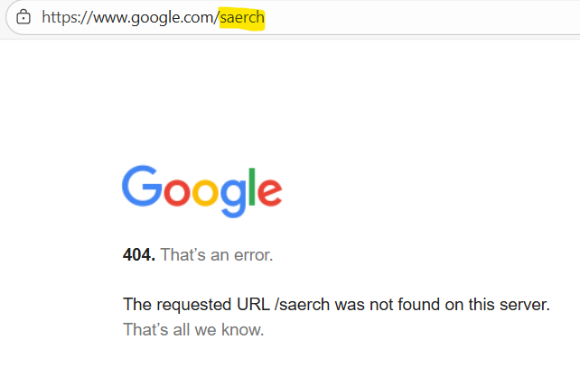
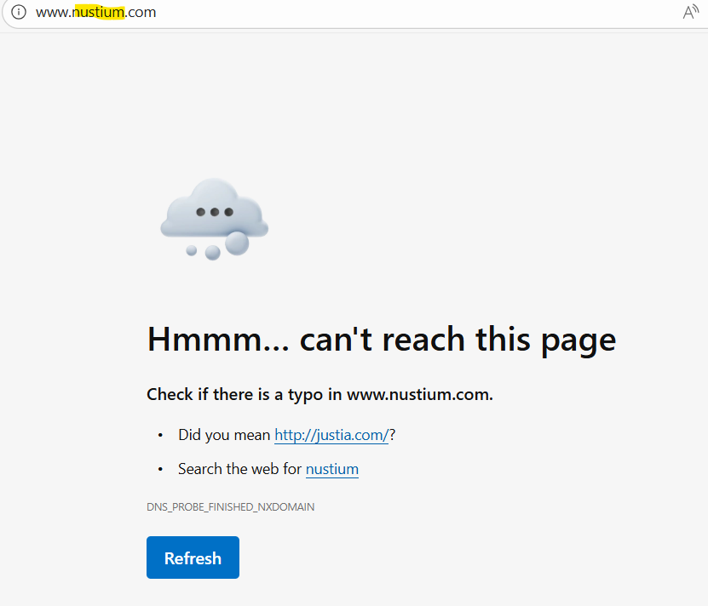
HTTP response status codes

Slide 21
HTTP response message
HTTP request message:
  Resource requested by the client is returned from the web server to the web browser.
HTTP Response messages has 3 main parts:
  Status Line = Tells the browser whether the request succeeded or failed, HTTP version, status code
  Header Line = Give extra information about the response e.g content type(type of data), content length(size of response), server (server software) etc..
  Body/Data= The actual content requested by the client. e.g PDF file, image or HTML file
Application Layer
2-<number>

Slide 22
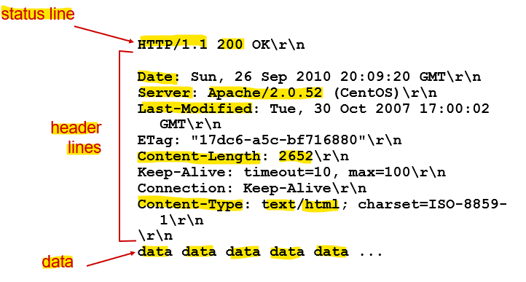
HTTP response message
Application Layer
2-<number>

Slide 23
Electronic mail
outgoing
message queue
Three major components:
user agents
mail servers
simple mail transfer protocol (SMTP)
1. User Agent
App used for composing, editing, and reading mail messages
Sends SMTP requests to server
e.g., Outlook, Thunderbird
user mailbox
user
agent
mail
server
user
agent
SMTP
mail
server
user
agent
SMTP
SMTP
user
agent
mail
server
user
agent
user
agent
Application Layer
2-<number>

Slide 24
Electronic mail: mail servers
2. Mail servers:
mailbox stores incoming messages for user
message queue holds outgoing mails waiting to be delivered
3. SMTP protocol
Sends mails between clients and servers
  Client role: sends mail to server
  Server role: receives email from client
user
agent
mail
server
user
agent
SMTP
mail
server
user
agent
SMTP
SMTP
user
agent
mail
server
user
agent
user
agent
Application Layer
2-<number>

Slide 25
Electronic Mail: SMTP
SMTP uses TCP to reliably transfer email messages from client to server, port 25
Direct transfer: sending server to receiving server (communication is between mail servers)
Three phases of mail transfer
  Handshaking (servers establish connection)
  Transfer of messages (mail exchange)
  Closure (connection closed)
Application Layer
2-<number>

Slide 26


Scenario: Anna sends message to Ben
1) Anna uses user agent to compose message “to” ben@nust.na
2) Anna’s user agent sends message to her mail server; message placed in message queue.
3) Anna’s mail server opens a TCP connection with Ben’s mail server
4) Anna’s message is sent to Bens’ mail server over the TCP connection
5) Ben’s mail server places the message in Ben’s mailbox
6) Ben invokes his user agent to pull and read message
user
agent
mail
server
user
agent
1
mail
server
2
3
6
4
Anna’s mail server
5
Ben’s mail server
Application Layer
2-<number>

Slide 27
Mail message format
SMTP: protocol for exchanging email messages
message format:
header lines, e.g.,
  To:
  From:
  Subject:
Body: the “message”
header
blank
line
body
Application Layer
2-<number>

Slide 28
Mail access protocols
user
agent
mail access
protocol
user
agent
SMTP
SMTP
(e.g., POP,
IMAP)
sender’s mail
server
receiver’s mail
server
SMTP: handles the exchange of messages between email servers over a network.
Mail Access Protocol: handles retrieval of mails from mail server
  POP: Post Office Protocol - used to retrieve email to a single client.
  IMAP: Internet Mail Access Protocol - used to retrieve mails for multiple clients.
Application Layer
2-<number>

Slide 29
POP3 and IMAP
POP3
Downloads email from server to client device
Email is deleted from the server
  E.g Example:
  If you open your email on your laptop, it downloads there.
  If you later check on your phone or different computer, the email may not be there.
  Email deleted from device is gone permanently.
  Uses port 110
IMAP
Emails stay stored on the server
Syncs changes (read, delete, folders) across devices
E.g You can access emails on Phone, PC, Tablet.
If you read an email on your phone, it shows as read on your laptop too. (sync)
Uses 143
Application Layer
2-<number>

Slide 30
File Transfer Protocol (FTP)
Protocol used for transfer of files between devices over a network by providing access to directories or folders on remote computers (server).
How FTP works:
FTP uses a client-server model.
The end-user(client) in the connection is known as localhost and the server which provides data is known as the remote host.
Uses TCP port 21 by default.
FTP Provides little to no security - Transfers data in plain text
All information is transferred in plain text. Therefore, only suitable for the distribution of public files.
Secure Alternative:
To secure FTP you can use SFTP instead, which uses port 22.
SFTP (Secure File Transfer Protocol) runs over SSH (Secure Shell). SSH performs data encryption.
Application Layer
2-<number>

Slide 31
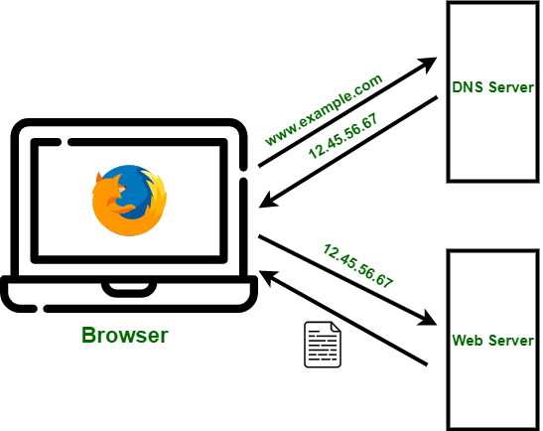
Domain Name System (DNS)
Translates hostnames [www.nust.na] to IP addresses [196.216.167.98]
DNS enables users to access services using human-readable names instead of numeric IP addresses. DNS service Uses port 53.
The process of looking up a domain name and its associated IP address is called name resolution. Example www.google.com → 142.251.47.100

Slide 32
DNS Architecture
DNS is a distributed and hierarchical database
No single server stores all domain mappings
Organized into levels:
1. Root Servers
2. Top-Level Domain (TLD) servers
3. Authoratative servers
Each level delegates responsibility to the next.
Application Layer
2-<number>

Slide 33
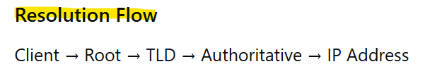
DNS Architecture
DNS server levels:
1. Root Servers
Highest level in DNS hierarchy
Direct queries to correct TLD server
2. Top-Level Domain (TLD) servers –
Responsible for domain extensions (.com, .org, .na)
Direct queries to the domain’s authoritative server
3. Authoratative servers
Store actual DNS records & Provide the final IP address
Application Layer
2-<number>

Slide 34
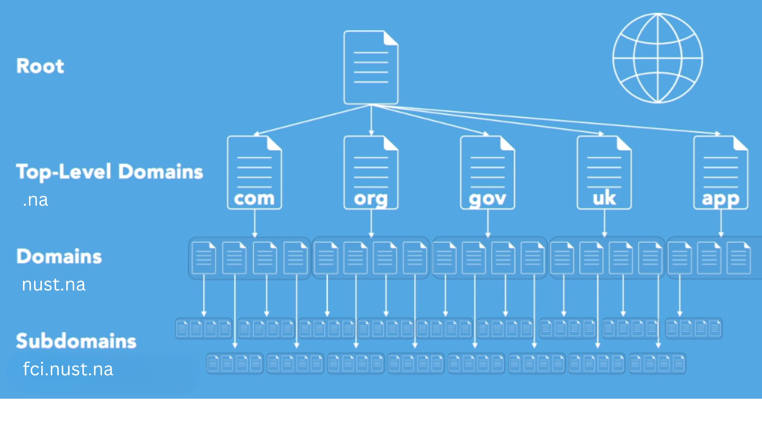
DNS Server levels
Application Layer
2-<number>

Slide 35
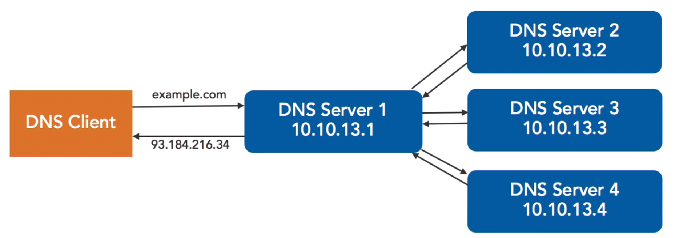
1. Recursive DNS Query
DNS Resolution – Query types
The DNS server communicates with several other DNS servers to hunt down an IP address and return it to the client.
The default DNS query type.

Slide 36
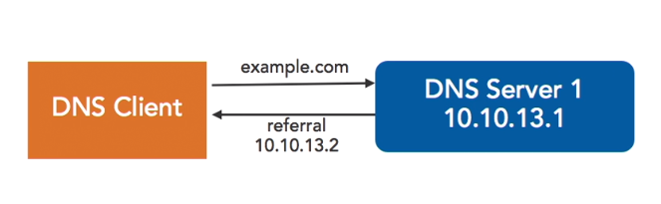
2. Iterative DNS Query
DNS Resolution…
The DNS Client makes repeated DNS (Domain Name System) Queries to different DNS Servers for name resolution through referrals. The process repeats until the IP address is found or no more referrals are available.
Also known as a “non-recursive DNS query”.
Application Layer
2-<number>

Slide 37
DNS Resolution…
Example
What happens when a browser, running on some student’s host, requests the URL https://www.nust.na/?
User types a domain name into a browser (www.nust.na)
The computer sends a DNS query to the local DNS server.
The local DNS server responds with an IP address (196.216.167.98)
What happens if the local DNS does not know the answer to your query?
Application Layer
2-<number>

Slide 38
DNS Resolution…
If a DNS Server (local) doesn’t know the IP address of a queried domain/hostname it contacts other DNS servers – Root> TLD >authoritative server.
The root servers are responsible for holding information about all of the top-level domains and are administered by the IANA.
Organisations designate servers that are authoritative for their domains.
DNS HIERARCHY
Application Layer
2-<number>

Slide 39
END
Application Layer
2-<number>

